Slide 1
Solution Optimization for Microsoft Foundry Lifecycle
Name
Title

Slide 2
Conditions and terms of use
© Microsoft Corporation. All rights reserved.
You may use these training materials solely for your personal internal reference and non-commercial purposes. You may not distribute, transmit, resell or otherwise make these training materials available to any other person or party without express permission from Microsoft Corporation. URL’s or other internet website references in the training materials may change without notice. Unless otherwise noted, any companies, organizations, domain names, e-mail addresses, people, places and events depicted in the training materials are for illustration only and are fictitious. No real association is intended or inferred. THESE TRAINING MATERIALS ARE PROVIDED “AS IS”; MICROSOFT MAKES NO WARRANTIES, EXPRESS OR IMPLIED IN THESE TRAINING MATERIALS¹

Slide 3
Agenda
Microsoft Foundry models
Model Lifecycle Guidance
Model Lifecycle FAQs
Resources & Next Steps
Notes:
Richard

Slide 4
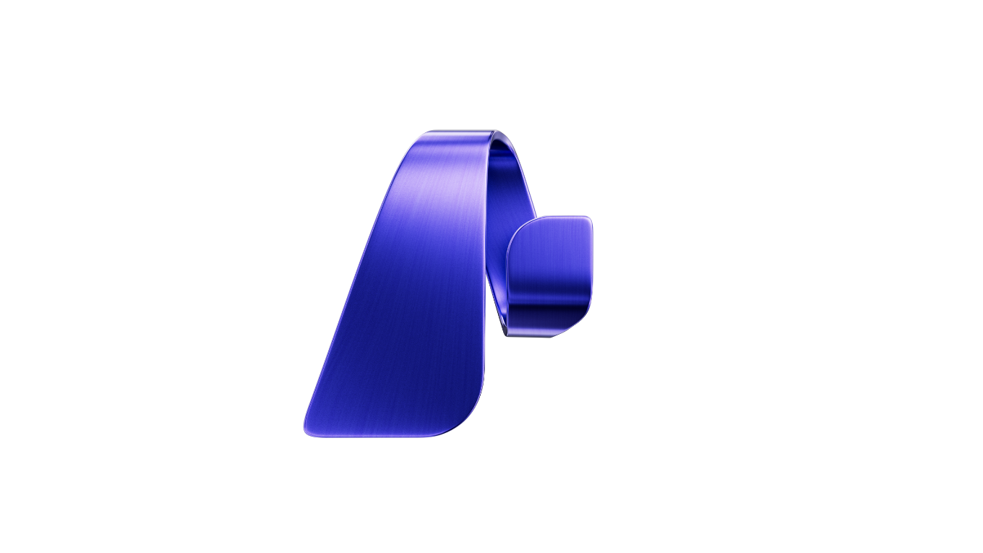
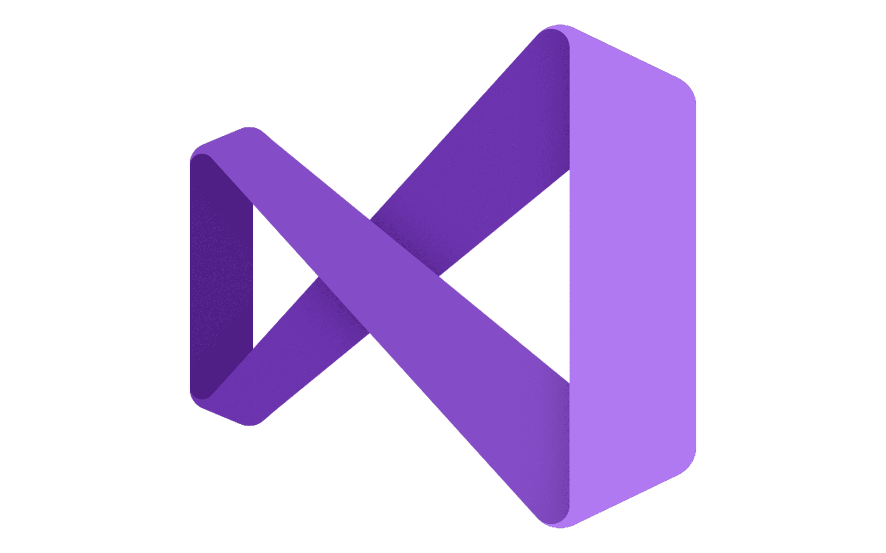






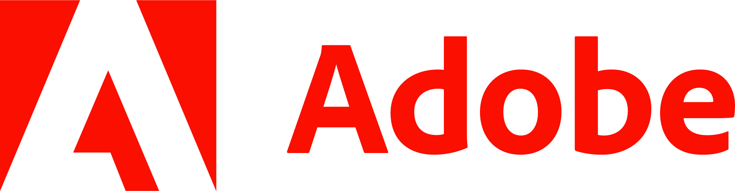










Microsoft Foundry
Streamline development with native IDE experiences
GitHub
Visual Studio
Visual Studio Code
Copilot Studio
Models
Agent Service
IQ
Tools
Machine Learning
Build context-aware and action-oriented agents with 1,400+ pre-built connections and MCP tools
Microsoft Bing
Microsoft Fabric
Microsoft OneLake
Control Plane
Leverage a complete signals management layer with Microsoft Security integrations
Microsoft Agent 365
Microsoft Defender
Microsoft Purview
Microsoft Entra
Security, compliance, and governance
Notes:
And regardless of how you build your AI apps and agents, where your store your data, or store your tools, they are all backed by Microsoft Foundry and the full stack that Microsoft offers.

Slide 5





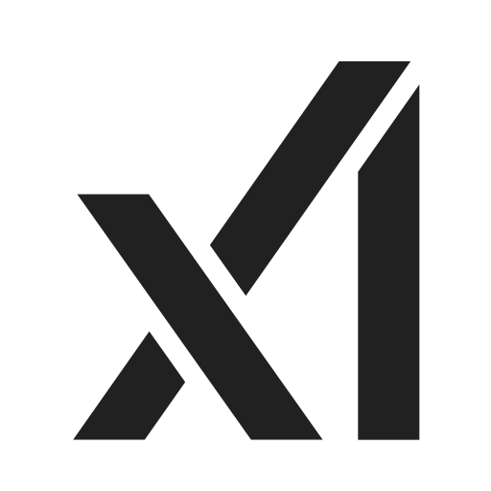


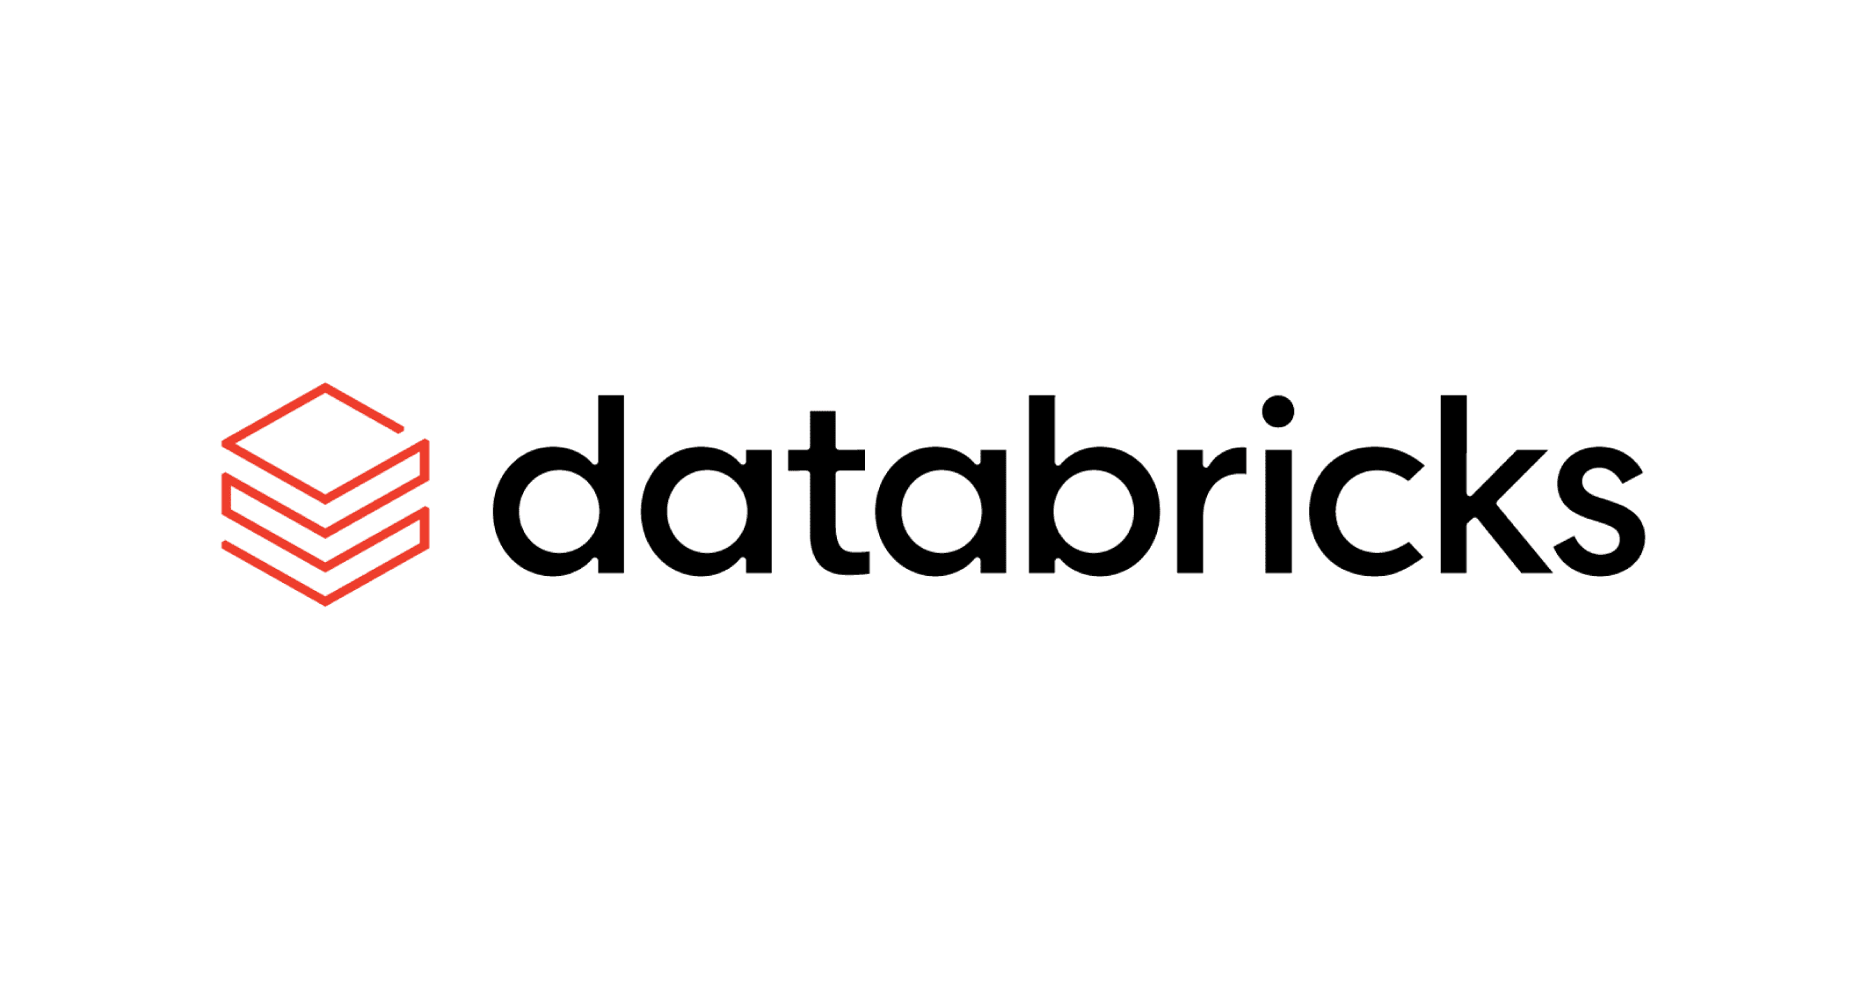





Microsoft Foundry Models
Every model. Every use case.
One platform.
11,000+ Frontier, specialized and open models
in Microsoft Foundry Models
Azure OpenAI
Claude in Microsoft Foundry
Azure DeepSeek
Azure Mistral
Azure Grok
Azure Cohere
Azure Black Forest Labs
Azure Llama
Avoid model lock-in:
  Flexible model selection
  Curated for organizations
  Explore, compare, evaluate and
  swap models with ease
and models from
Hugging Face
NVIDIA
Nixtla
Databricks
Notes:
In any factory, you start with raw materials. For AI apps and agents, we start with models. Models are the foundation, the brain, of any agent.
Microsoft Foundry Models empower developers to access more than 11,000 models, deploy with confidence, and optimize for performance—while accelerating AI innovation at scale.
With Foundry Models, developers can discover and evaluate models for their use cases by performance and key parameters. They can integrate them into their code with a unified API, change models without coding, and automatically upgrade modes to optimize costs. And Microsoft Foundry offers consistent AI performance across cloud, local devices, and on-premises for hybrid operations.
To provide reliability at scale, we’ve introduced reserved capacity for models hosted and sold by Microsoft (like xAI3, Mistral, Black Forest Labs, and DeepSeek) – in addition to Azure OpenAI models, so developers have consistent performance even under heavy load. In addition, models hosted and sold by Microsoft offer:
SLA & compliance
Cost savings since you can share PTU quota among models
All Foundry Models will be accessible through a unified API and the Models MCP Server, making it seamless to go from prototype to production.

Slide 6





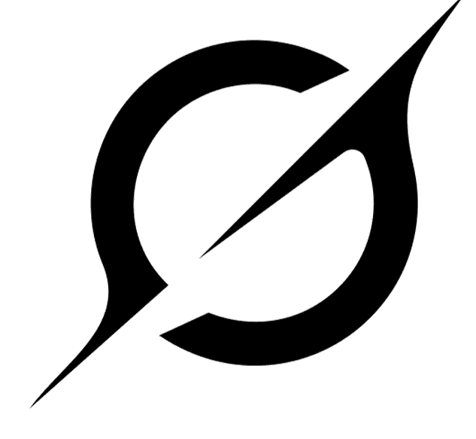












Microsoft Foundry Models Offering 11,000+ frontier and open models
Azure OpenAI
GPT-5
GPT-4o/GPT-4o mini
GPT-Image-1
o1/o1-mini
o3/o3-mini
o4-mini
Sora
GPT-4.1/ 4.1-mini/4.1-nano
Dall*E-3
Whisper
Anthropic
Claude Haiku 4.5
Claude Sonnet 4.5
Claude Opus 4.5/4.1
DeepSeek
DeepSeek-R1
DeepSeek-V3 0324, V3.1
MAI-DS-R1 (Microsoft AI)
Meta
Meta-Llama-3
Meta-Llama-3.1-405B
Llama-3.2
Llama-3.3
Llama4-Scout
Llama4-Maverick
CodeLlama
Llama-Guard
Mistral AI
Mistral Document AI
Mistral Large 3
Mistral Medium 3
Mistral Nemo
Mistral Small
Mistral 7B
Mixtral 8x7B –
Mixture of Experts
Codestral
Mistral OCR
Cohere
Command R+
Command R
Command A
Cohere Rerank 4
Embed v3-Multilingual
Embed v3-English
Embed 4
Microsoft
Phi-4
Phi-4-mini
Phi-4-mini-reasoning
Bitnet, Magma
Aurora, BioEmu
OmniParser v2
xAI
Grok 3,Grok 3 mini
Grok Code Fast 1
Grok 4, Grok 4 Fast
Black Forest
Labs
Flux Pro 1.1, Flux.1 Kontext Pro
Hugging Face
Qwen QwQ 32b
DeepCogito
Seethal Sentiment
Roberta
Google Flan
Intel Bert
Cross Encoder
Intfloat Multilingual E5
Cerebras
NVIDIA
Nemotron-3-8B-4k
Nemotron-3-8B-Chat-SFT/
RLHF/SteerLM
Nemotron-3-8B-QA
NIMS microservices inc:
Mistral 7B Instruct v0.3
DeepSeek R1 Distill Llama
Mixtral 8x7B Instruct
Llama 3.2 NV Rerank QA
Stability
Stable Diffusion
Stable Image Ultra
Databricks
Databricks/dbrx-base
Databricks/dbrx-instruct
Industry Models
Fidelity/Saifr
Sight Machine
Bayer
Cerence
Paige AI
Prism
Rockwell
Virchow
RA-FT-Optix
Core 42
JAIS
Gretel
Navigator
Bria
Bria 2.3 Fast
Snowflake
Snowflake/arctic-base
Snowflake/arctic-instruct
SDAIA
ALLaM-2-7b-instruct
Deci
DeciCoder
DeciDiffusion
Nixtla
Time GEN-1
NTT DATA
Data Tsuzumi
*Direct from Azure Models
Notes:
In Microsoft Foundry We believe model choice is important. At this very moment, with thousands of models available. Whether you are seeking the most advanced reasoning, a computer use agent, an industry-based or domain-specific model, or a model suited for the task, Foundry has the models to help you get what you need done.
Link : Azure AI model breadth.pptx (sharepoint.com)

Slide 7
Microsoft Foundry
Models Direct From Azure
Azure-hosted, Azure-sold, licensed and supported directly by Microsoft
Azure
OpenAI
Azure DeepSeek
Azure
Mistral AI
Azure
Grok
Azure Cohere
Azure Black
Forest Labs
Azure
Llama
Unified access
One portal for all models, billing, and governance
Scalable deployment
Flexible options including Provisioned Throughput
Enterprise-ready
Compliance, security, and SLA-backed reliability
Notes:
Today we’re announcing more serverless models directly sold by Microsoft.
Unified Access: Seamlessly access Azure OpenAI, Microsoft models, partner-hosted models, and open-source LLMs in one place.
Scalable Deployment: Deploy AI workloads faster with flexible options across serverless, managed, and provisioned compute.
Enterprise-Ready: Built-in security, governance, and compliance features to meet enterprise AI requirements at scale.
New models are joining Azure as direct, first-party offerings. These include Azure Llama, Azure Grok, Azure Mistral, and Azure Flux.

Slide 8
Models Direct from Azure
Models Direct
from Azure
Service
Standard
Batch
Provisioned
Purchase type
Global
Data Zones
Regional
Global
Data Zones
Global
Data Zones
Regional
Deployment
location

Slide 9
Deployment Types
Platform
Microsoft Foundry
Offer
Standard
Priority Processing
Provisioned
Batch
Deployment
Global
Data Zones
Regional
SLA
SLA
SLA
SLA
SLA
Standard Global
Standard Data Zones
Global
Data Zones
Regional
Global
Data Zones
New
New

Slide 10
Choosing the best offer type
Standard
Provisioned
Batch
Ideal for most use cases |  | Easy access with high and predictable throughput |  | Lower cost processing of large volumes of data
Easy to get started and scale up to production |  | Real-time scoring for large consistent volume |  | Scalable to handle varying workloads
Cost-effective for low to medium scale deployments |  | Cost effective for large-scale deployments |  | Cost-effective for large-scale deployments
GOOD FOR: Production workloads Development and testing Prototyping and proof of concept |  | RECOMMENDED FOR: Production workloads High volume data processing Throughput heavy workloads Real-time applications with minimal latency |  | RECOMMENDED FOR: Large-scale data processing Generate large volumes of content Transforming data at scale Evaluate LLM models and assess comprehensive performance
Notes:
In the realm of AI deployments, choosing the right offer is pivotal for aligning with your business objectives. The Azure OpenAI Service provides two distinct offerings: Standard and Provisioned. The Standard offering is optimized for low to medium volume workloads and offers flexibility with Pay-per-call pricing. This flexible, usage-based model with variable costs and capped throughput, is ideal for development, testing, and lower-volume production workloads.
On the other hand, the Provisioned offering is designed for high volume workloads and throughput-heavy applications, offering predictable costs with hourly billing and the option for Azure Reservations. It offers a consistent cost structure and scalable throughput, suitable for production and high-volume workloads that need guaranteed latency.
It’s essential to consider your workload’s nature and requirements when selecting the best offer to ensure efficiency and cost-effectiveness.

Slide 11
Choosing the best deployment location
Global
Data Zone
Regional
Lowest price with highest throughput |  | Cross region load balancing within a geographic boundary (US or EU) |  | Specifical data processing
Broadest model availability |  | Broader model availability |  | Limited model availability
Broadest capacity availability |  | Broader capacity availability |  | Limited capacity availability
BEST FOR: Applications requiring a consistent experience across multiple regions Services needing to be available globally with low latency Cost savings is a priority Data residency independent of deployment |  | BEST FOR: Applications needing more processing capacity with data residency required Cost saving with meeting compliance requirements Optimal access to latest AI models and innovations |  | BEST FOR: Applications required to meet data residency compliance globally with low latency Services needing to be closer to the end-users to reduce latency Applications requiring localized data processing and storage
Notes:
Global last bullet point- all resources data at rest in the resource region, independent of the deployment type.
In the realm of AI deployments, choosing the right offer is pivotal for aligning with your business objectives. The Azure OpenAI Service provides two distinct offerings: Standard and Provisioned. The Standard offering is optimized for low to medium volume workloads and offers flexibility with Pay-per-call pricing. This flexible, usage-based model with variable costs and capped throughput, is ideal for development, testing, and lower-volume workloads.
On the other hand, the Provisioned offering is designed for high volume workloads and throughput-heavy applications, offering predictable costs with hourly billing and the option for Azure Reservations. It offers a consistent cost structure and scalable throughput, suitable for production and high-volume workloads that have strict latency requirements.
It’s essential to consider your workload’s nature and requirements when selecting the best offer to ensure efficiency and cost-effectiveness.

Slide 12

Models from partners and community
From agile prototyping to high-scale production
Claude in Microsoft Foundry
Cohere
Model Family
Hugging Face
Collection
NVIDIA Model Family
Nixtla Time-Gen1 Model
Databricks
Model Family
Unmatched breadth
Innovate with the best
Enterprise-grade
reliability
Notes:
With the introduction of innovative models from DeepSeek, xAI, Meta, and Mistral gaining significant attention in the industry, customers are now seeking service parity with Azure OpenAI models.
Azure Direct Models are trusted models hosted and sold by Microsoft. They provide fungible provisioned throughput, simplify deployment experiences, and enterprise-grade security. These models include OpenAI, DeepSeek, Microsoft, Grock from xAI, Llama 4 from Meta, Flux from ?, and Mistral OCR from Mistral.
Our partner and community models offer

Slide 13
Models from Partner and Community
Managed compute
Customers deploy models on their own Azure compute​
Suitable for those with dedicated GPU investments or custom stacks​
Supports workload predictability and governance
​
Enables monetized model usage directly via Microsoft Foundry
100s of open models
      Standard
On-demand (pay-go) compute with flexible billing​
Great for customers without pre-allocated GPU/VM quota​
Ideal for teams evaluating models or experimenting with use cases
30+ flagship models
Notes:
With the introduction of innovative models from DeepSeek, xAI, Meta, and Mistral gaining significant attention in the industry, customers are now seeking service parity with Azure OpenAI models.
Azure Direct Models are trusted models hosted and sold by Microsoft. They provide fungible provisioned throughput, simplify deployment experiences, and enterprise-grade security. These models include OpenAI, DeepSeek, Microsoft, Grock from xAI, Llama 4 from Meta, Flux from ?, and Mistral OCR from Mistral.
Our partner and community models offer

Slide 14
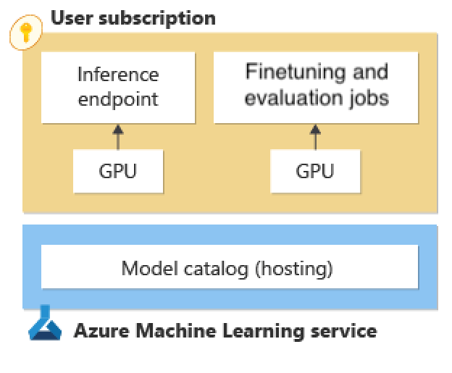
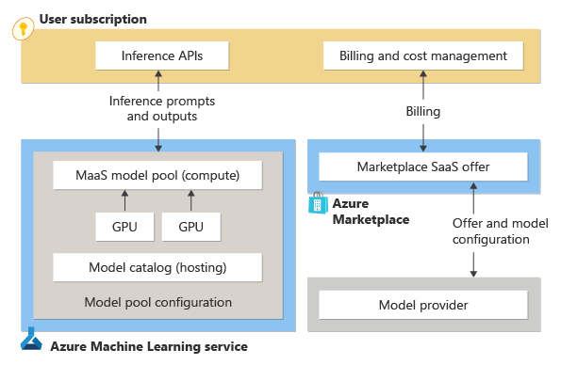
Models from Partner and Community
Managed compute
Standard
Customers deploy models on their own Azure compute​
Suitable for those with dedicated GPU investments or custom stacks​
Supports workload predictability and governance
Enables monetized model usage directly via Microsoft Foundry
100s of open models
On-demand (pay-go) compute with flexible billing​
Great for customers without pre-allocated GPU/VM quota​
Ideal for teams evaluating models or experimenting with use cases
30+ flagship models
Notes:
Your prompts and completions are not shared with model providers
Your prompts and completions not used for training models

Slide 15
Model selection simplified
Use the best model throughout model lifecycle
Model Router
A/B experimentation
Model benchmarks
Model selection simplified
Automated evaluation
Model leaderboards
Performance monitoring
AI templates
Model inference API
Select the best model
Continue using the best model
Notes:
We’ve made model selection radically easier. From benchmarks to leaderboards to A/B testing, you can evaluate and iterate. And with Model Router, you can automatically route to the best model for your needs, optimizing for quality, speed, or cost
The Microsoft Foundry difference:
Automated model routing,
Fully customizable and context-aware templates,
Real-time performance monitoring
Model selection with Microsoft Foundry is special because it supports the complete AI lifecycle.
When you’re prototyping and looking to identify your most promising models, you can run performance benchmarks
Under this same roof, you can optimize your models through testing and iteration using automated evaluations and swap models with Model inference API
And as you operationalize at scale, automated post-production evaluations and A/B testing help you measure ongoing quality and safety in production
Microsoft Foundry gives you a unified API, built-in tooling for benchmarking, evaluations, experimentation and versatile deployment (serverless APIs or provisioned throughput) for all stages of AI projects.
The model router automatically selects the best model for your prompt, resulting in higher quality and lower cost outputs.
Developers can easily switch models and compare performance. A complete set of SDKs for models and access from popular Developer platforms (GitHub), IDEs (Visual Studio) and frameworks (LangChain and Semantic Kernel).

Slide 16
Model Life Cycle Guidance

Slide 17
Model lifecycle stages
Preview
Models labeled Preview are experimental in nature. A model's weights, runtime, and API schema can change while the model is in preview. Models in preview aren't guaranteed to become generally available. Models in preview have a Preview label next to their name in the model catalog.
Generally Available
This stage is the default model stage. Models that don't include a lifecycle label next to their name are GA and suitable for use in production environments. In this stage, model weights and APIs are fixed. However, model containers or runtimes with vulnerabilities might get patched, but patches don't affect model outputs.
*Legacy
Models labeled Legacy are intended for deprecation. You should plan to move to a different model, such as a new, improved model that might be available in the same model family. While a model is in the legacy stage, existing deployments of the model continue to work, and you can create new deployments of the model until the deprecation date.
Deprecated
Retired
Models labeled Deprecated are no longer available for new deployments. You can't create any new deployments for the model; however, existing deployments continue to work until the retirement date.
Models labeled Retired are no longer available for use. You can't create new deployments and attempts to use existing deployments return <return code> errors.
*Not used for Azure OpenAI Models

Slide 18
Model availability of Azure OpenAI Models
Generally Available (GA) model versions will be available for a minimum of 12 months.
After 12 months, existing customers may continue to use older model versions for an additional six months.
New customers who have never deployed the older model version will no longer have access after 12 months.
For global deployments, all future model versions starting with gpt-4o and gpt-4 0409 will be available with their (N) next succeeding model (N+1) for comparison together.
Customers have 60 days to try out a new GA model in at least one global or standard region before any upgrades happen to a newer GA model.

Slide 19
Terminology Specific to Azure OpenAI Models
Deprecation: When a model is deprecated, it's no longer available for new customers. It continues to be available for use by customers who have existing deployments until the model is retired.
Retirement: When a model is retired, it's no longer available for use. Azure OpenAI deployments of a retired model always return error responses.

Slide 20
Notifications for Foundry Models
Models are labeled as Legacy and remain in the legacy state for at least 30 days before being moved to the deprecated state. During this notification period, you can create new deployments as you prepare for deprecation and retirement.
Models are labeled Deprecated and remain in the deprecated state for at least 90 days before being moved to the retired state. During this notification period, you can migrate any existing deployments to newer or replacement models.
Notes:
Customers that have Foundry Model deployments receive notifications for upcoming model retirements according to the following schedule:
For each subscription that has a model deployed as a serverless API deployment or deployed to a Foundry resource, members of the owner, contributor, reader, monitoring contributor, and monitoring reader roles receive a notification when a model deprecation is announced. The notification contains the dates when the model enters legacy, deprecated, and retired states. The notification might provide information about possible replacement model options, if applicable.

Slide 21
Notifications for Azure OpenAI in Foundry Models
At model launch, we programmatically designate a "not sooner than" retirement date.
At least 60 days notice before model retirement for Generally Available (GA) models.
At least 30 days notice before preview model version upgrades.
For preview models, it's 90-120 days from launch
For generally available (GA) models, it's 365 days from launch.
Notes:
For Azure OpenAI models, customers with active Azure OpenAI deployments receive notice for models with upcoming retirement as follows:
Members of the owner, contributor, reader, monitoring contributor, and monitoring reader roles receive notification for each subscription with a deployment of a model that has an upcoming retirement.
Retirements are done on a rolling basis, region by region.
There's no schedule for when a specific region or SKU is upgraded.
Notifications are sent from an unmonitored mailbox, azure-noreply@microsoft.com.

Slide 22
Notifications of upcoming retirements
Azure Resource Health: Anyone with reader permissions or higher can see Azure health alerts and configure personalized alerts via email and SMS. See Create Service Health alerts.
Email: Email notifications are automatically sent to subscription owners. However, any individual with reader permissions can configure their own alerts by following the previous guidance.

Slide 23
Model version Notification
Azure publishes when new versions of models are released, and notifies customers at least two weeks before a new version becomes the default version of the model

Slide 24
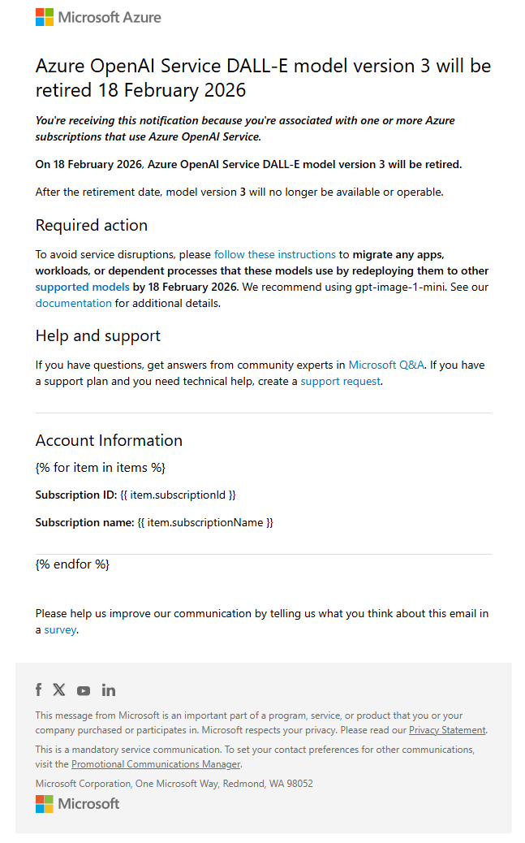
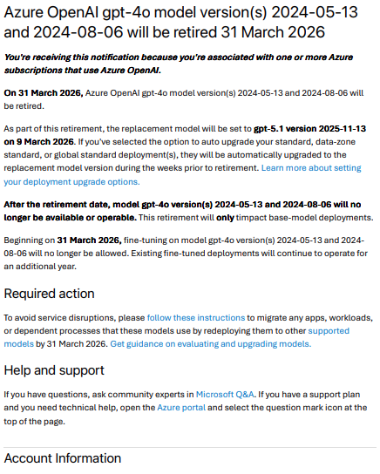

Slide 25
Considerations for Azure public cloud
Not all model version combinations will be available in all regions.
Model version N and N+1 might not always be available in the same region.
A GA model version N might upgrade to a future model version N+X in some regions based on capacity limitations, and without the new model version N+X separately being available to test in the same region. The new model version will be available to test in other regions before any upgrades are scheduled.

Slide 26
Considerations for Azure public cloud
Preview model versions and GA versions of the same model won't always be available to test together in the same region. There will be preview and GA versions available to test in different regions.
We reserve the right to limit future customers' use of a particular region to balance service quality for existing customers.
As always at Microsoft, security is of the utmost importance. If a model or model version is found to have compliance or security issues, we reserve the right to invoke the need to do emergency retirements. Refer to the terms of service for more information.

Slide 27
Special considerations for Azure Government clouds
Global standard deployments aren't available in government clouds.
Not all models or model versions available in commercial and public clouds will be available in government clouds.
In Azure Government clouds, we intend to support only one version of a given model at a time. For example, only one version of gpt-35-turbo 0125 and gpt-4o (2024-05-13).

Slide 28
Special considerations for Azure Government clouds
However, there's a 30-day overlap between new model versions, when more than two will be available. For example, if gpt-35-turbo 0125 or gpt-4o (2024-05-13) is updated to a future version. Another example is model family changes beyond version updates, like when moving from gpt-4 1106-preview to gpt-4o (2024-05-13).

Slide 29
Preparation for model retirements and version upgrades
To prepare for model retirements and version upgrades, we recommend that customers test their applications with the new models and versions and evaluate their behavior. We also recommend that customers update their applications to use the new models and versions before the retirement date.
For more information on the model evaluation process, see the Getting started with model evaluation blog post.
Not all models go through a deprecation period before retirement. Some models or versions only have a retirement date.

Slide 30
Considerations for Fine Tuned Models
Fine-tuned models are subject to a different deprecation and retirement schedule from their equivalent base model.
Fine-tuned models retire in two phases: training and deployment.
Unless explicitly stated, training retires no earlier than the base model retirement date. After a model is retired for training, it's no longer available for fine-tuning but any models you've trained remain available for deployment.
At deployment retirement, inference and deployment return error responses.

Slide 31
Upcoming Azure OpenAI Model Deprecations & Retirements
Model Name | Model Version | Lifecycle Status | Deprecation Date* (No New Customers) | Retirement Date* | Replacement Model
gpt-5-chat | 2025-08-07 | Preview | n/a | 2026-03-01 | gpt-5.2-chat
gpt-5-chat | 2025-10-03 | Preview | n/a | 2026-03-01 | gpt-5.2-chat
gpt-4o | 2024-05-13 | Generally Available | 2025-05-13 | 2026-03-31 | gpt-5.1
gpt-4o | 2024-08-06 | Generally Available | 2025-08-06 | 2026-03-31 | gpt-5.1
gpt-4o-mini | 2024-07-18 | Generally Available | 2025-07-18 | 2026-03-31 | gpt-4.1-mini
o1-pro | 2025-03-19 | Generally Available | 2026-03-19 | 2026-09-18 | o3-pro
o3-mini | 2025-01-31 | Generally Available | 2026-01-31 | 2026-08-02 | o4-mini
gpt-5.1-chat | 2025-11-13 | Preview | n/a | No earlier than 2026-03-31
gpt-4o-audio-preview | 2024-12-17 | Preview | n/a | 2026-02-02 | gpt-audio
gpt-4o-realtime-preview | 2024-12-17 | Preview | n/a | 2026-02-02 | gpt-realtime
gpt-4o-mini-audio-preview | 2024-12-17 | Preview | n/a | No earlier than February 28, 2026
gpt-4o-mini-realtime-preview | 2024-12-17 | Preview | n/a | No earlier than February 28, 2026
gpt-4o-transcribe | 2025-03-20 | Preview | n/a | No earlier than February 28, 2026
gpt-4o-mini-tts | 2025-03-20 | Preview | n/a | No earlier than February 28, 2026
gpt-4o-mini-transcribe | 2025-03-20 | Preview | n/a | No earlier than February 28, 2026
tts | 001 | Generally Available | No earlier than February 28, 2026
tts-hd | 001 | Generally Available | No earlier than February 28, 2026
whisper | 001 | Generally Available | No earlier than February 28, 2026
dall-e-3 | 3 | Generally Available | n/a | 2026-02-18 | gpt-image-1-mini
gpt-image-1 | 2025-04-15 | Preview | n/a | No earlier than 2026-03-31 | gpt-image-1-mini
sora | 2025-05-02 | Preview | n/a | No earlier than 2026-02-28 | sora-2
Notes:
Following are the Foundry Models from OpenAI deprecating and/or retiring in FY26 Q3. Notifications to the customers would be going out per product documentation here. Details in the below table may change in future so always refer to the updated product documentation here.

Slide 32
Upcoming Foundry Model Deprecations & Retirements
 | Model | Legacy date (UTC) | Deprecation date* (UTC) | Retirement date* (UTC) | Suggested replacement model
Cohere | Cohere-rerank-v3.5 | January 14, 2026 | February 14, 2026 | May 14, 2026 | Cohere-rerank-v4.0-pro, Cohere-rerank-v4.0-fast
Core42 | jais-30b-chat | September 30, 2025 | October 31, 2025 | January 30, 2026 | N/A
Mistral AI | Mistral-Nemo | September 30, 2025 | October 31, 2025 | January 30, 2026 | Mistral-small-2503
Mistral AI | Mistral-large-2411 | September 30, 2025 | October 31, 2025 | January 30, 2026 | Mistral-medium-2505
Mistral AI | Mistral-ocr-2503 | September 30, 2025 | October 31, 2025 | January 30, 2026 | Mistral-document-ai-2505
Notes:
Following are the Foundry Models from Cohere, Core42 & Mistral AI deprecating and/or retiring in FY26 Q3. Notifications to the customers would be going out per product documentation here. Details in the below table may change in future so always refer to the updated product documentation here.

Slide 33
Upcoming Deprecations & Retirements in US Gov cloud
Early Model Retirements
Model | Version | Azure Government Status | Public Retirement date
gpt-35-turbo | 1106 | Retired | November 14, 2025
gpt-4 | turbo-2024-04-09 | Retired | November 14, 2025
Late Model Retirements
Model | Version | Azure Government Status | Public Retirement date | Replacement Model | Upgrade date | Azure Government Retirement date
gpt-35-turbo | 0125 | Active | November 14, 2025 | gpt-4.1-mini | January 16, 2026 | February 15, 2026
Notes:
Following are the Foundry Models from Cohere, Core42 & Mistral AI deprecating and/or retiring in FY26 Q3. Notifications to the customers would be going out per product documentation here. Details in the below table may change in future so always refer to the updated product documentation here.

Slide 34
Upcoming Deprecations & Retirements for Fine Tuned Models
Training retirement date if for existing customers only. Otherwise, training retirement occurs at base model retirement.
Model | Version | Training retirement date | Deployment retirement date
gpt-4o | 2024-08-06 | No earlier than 2026-09-31¹ | 2027-03-31
gpt-4o-mini | 2024-07-18 | No earlier than 2026-09-31¹ | 2027-03-31
gpt-4.1 | 2025-04-14 | Base model retirement | One year after training retirement
gpt-4.1-mini | 2025-04-14 | Base model retirement | One year after training retirement
gpt-4.1-nano | 2025-04-14 | Base model retirement | One year after training retirement
o4-mini | 2025-04-16 | Base model retirement | One year after training retirement

Slide 35
Standard Model Upgrades

Slide 36
Model updates
Azure OpenAI supports automatic updates for select model deployments. On models where automatic update support is available, a model version upgrade policy drop-down is available
Automatic model updates are only supported for Standard deployment types
Update policies are configured per deployment and vary by model and provider.

Slide 37
Model updates
Deployments set to Auto-update to default automatically update to use the new default version.
Deployments set to Upgrade when expired automatically update when its current version is retired.
Deployments that are set to No Auto Upgrade stop working when the model is retired.
Notes:
When you deploy a model you can choose an update policy, which can include the following options:

Slide 38
Auto update to default
When you set your deployment to Auto-update to default, your model deployment is automatically updated within two weeks of a change in the default version. For a preview version, it updates automatically when a new preview version is available starting two weeks after the new preview version is released.
If you're still in the early testing phases for inference models, we recommend deploying models with auto-update to default set whenever it's available.

Slide 39
Specific model version
As your use of Azure OpenAI evolves, and you start to build and integrate with applications you might want to manually control model updates. You can first test and validate that your application behavior is consistent for your use case before upgrading.
When you select a specific model version for a deployment, this version remains selected until you either choose to manually update yourself, or once you reach the retirement date for the model. When the retirement date is reached the model will automatically upgrade to the default version at the time of retirement.

Slide 40
Model deployment upgrade configuration
Option | Read | Update
REST | Yes. If versionUpgradeOption isn't returned, it means it's null | Yes
Azure PowerShell | Yes.VersionUpgradeOption can be checked for $null | Yes
Azure CLI | Yes. It shows null if versionUpgradeOption isn't set. | No. It's currently not possible to update the version upgrade option.
Name | Description
OnceNewDefaultVersionAvailable | Once a new version is designated as the default, the model deployment automatically upgrades to the default version within two weeks of that designation change being made.
OnceCurrentVersionExpired | Once the retirement date is reached the model deployment automatically upgrades to the current default version.
NoAutoUpgrade | The model deployment never automatically upgrades. Once the retirement date is reached the model deployment stops working. You need to update your code referencing that deployment to point to a nonexpired model deployment.
Notes:
You can check what model upgrade options are set for previously deployed models using REST, Azure CLI, and Azure PowerShell, as well as with the Foundry portal.
The corresponding property can also be accessed via REST, Azure PowerShell, and Azure CLI.

Slide 41
Provisioned Model Migration

Slide 42
Managing models on provisioned deployment types
In-place migrations
Multi-deployment migrations
Notes:
Provisioned deployments support distinct model management practices. Provisioned deployment model management practices are intended to give you the greatest control over when and how you migrate between model versions and model families.
Currently, there are two approaches available to manage models on provisioned deployments

Slide 43
Prerequisites
Validate that the target model version or model family is supported for your existing deployment type. Migrations can only occur between provisioned deployments of the same deployment type.
Validate capacity availability for your target model version or model family prior to attempting a migration.
For multi-deployment migrations, validate that you have sufficient quota to support multiple deployments simultaneously.

Slide 44
In-place migrations for provisioned deployments
In-place migrations allow you to maintain the same provisioned deployment name and size while changing the model version or model family assigned to that deployment.
With in-place migrations, Azure OpenAI takes care of migrating any existing traffic between model versions or model families throughout the migration over a 20-30 minute window.

Slide 45
In-place migrations for provisioned deployments
Throughout the migration window, your provisioned deployment will display an "updating" provisioned state. You can continue to use your provisioned deployment as you normally would.
Once the in-place migration is complete, the provisioned state will be updated to "succeeded", indicating that all traffic has been migrated over to the target model version or model family.

Slide 46
In-place migration: model version update
In-place migrations that target updating an existing provisioned deployment to a new model version within the same model family are supported through Foundry, REST API, and Azure CLI. To perform an in-place migration targeting a model version update within Foundry, select Deployments > under the deployment name column select the deployment name of the provisioned deployment you would like to migrate.
Selecting a deployment name opens the Properties for the model deployment. From this view, select the edit button, which will show the Update deployment dialogue box. Select the model version dropdown to set a new model version for the provisioned deployment. As noted, the provisioning state will change to "updating" during the migration and will revert to "succeeded" once the migration is complete.

Slide 47
In-place migration: model family change
In-place migrations that target updating an existing provisioned deployment to a new model family are supported through REST API and Azure CLI.

Slide 48
Multi-deployment migrations for provisioned deployments
Create a new provisioned deployment by choosing to maintain the same or different provisioned deployment type as your existing deployment
Transition traffic from the existing provisioned deployment to the newly created provisioned deployment with your target model version or model family
Once traffic is migrated over to the new deployment, validate that there are no inference requests being processed on the previous provisioned deployment.
Once you confirm that no inference calls have been made, delete the original provisioned deployment.
Notes:
Multi-deployment migrations allow you to have greater control over the model migration process. With multi-deployment migrations, you can dictate how quickly you would like to migrate your existing traffic to the target model version or model family on a new provisioned deployment. The process to migrate to a new model version or model family using the multi-deployment migration approach is as follows:

Slide 49
Available tools and example prompts for Foundry MCP Server (preview)
model_deprecation_info_get (read)
Get deployment info enriched with deprecation data.
Example prompts include:
"Check if my production deployment is using a deprecated model version."
"Get deprecation information for my legacy-chatbot deployment."
"Are any of my current deployments scheduled for retirement?"
Notes:
https://learn.microsoft.com/en-us/azure/ai-foundry/mcp/available-tools?view=foundry#model-monitoring-and-operations

Slide 50
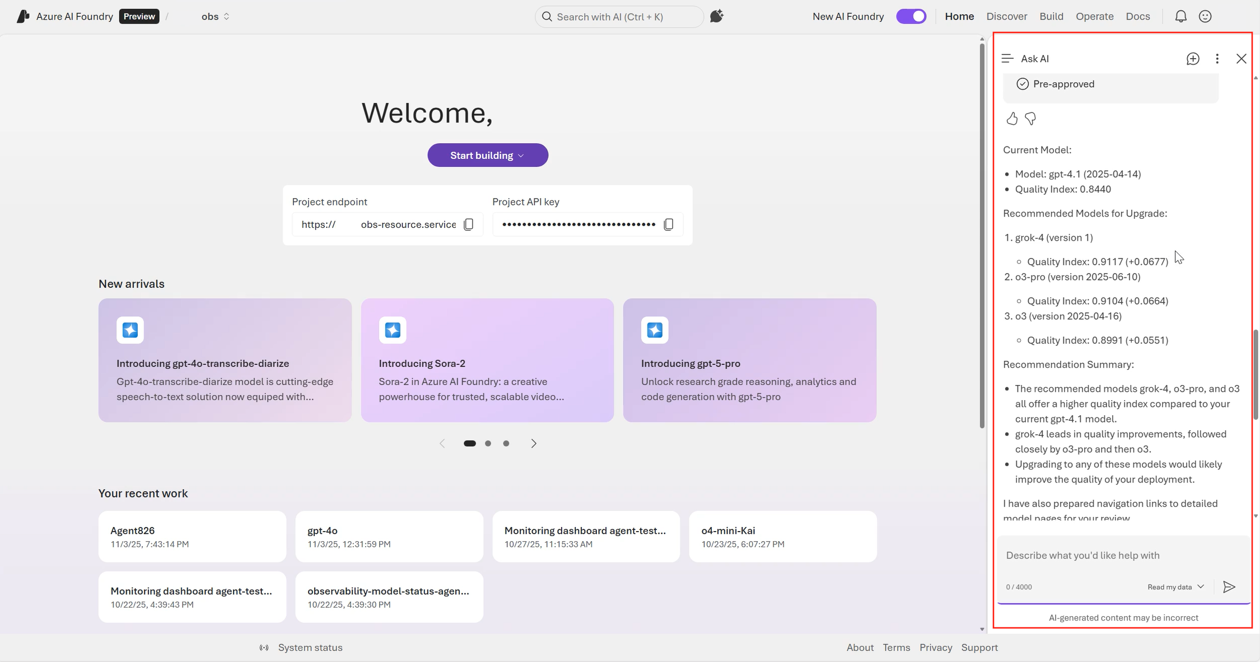
Upgrade/switch models in Microsoft Foundry with Ask AI (preview)
Notes:
Upgrade/Switch Models in Microsoft Foundry with Ask AI - Microsoft Foundry | Microsoft Learn

Slide 51
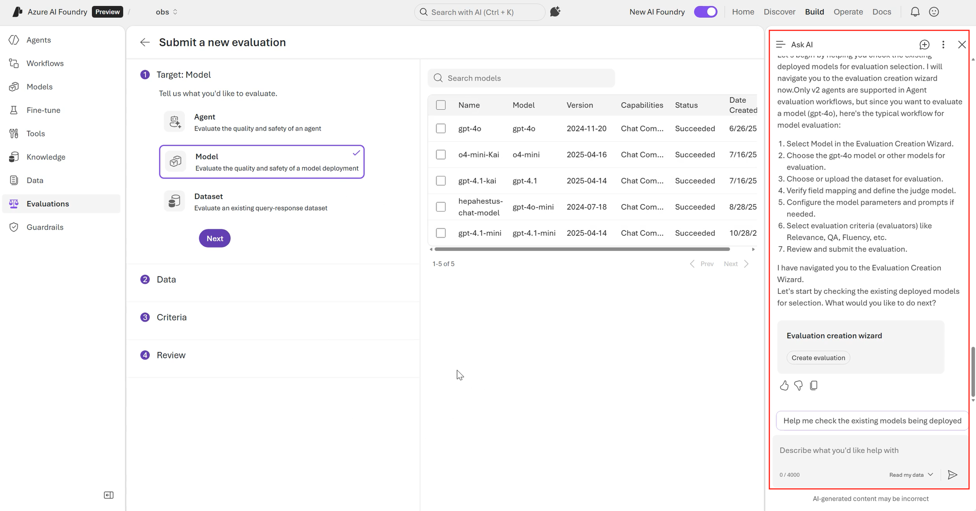
Upgrade/switch models in Microsoft Foundry with Ask AI (preview)

Slide 52
Preview Models
We don't recommend using preview models in production. We'll upgrade all deployments of preview models to either future preview versions or to the latest stable, generally available version. Models that are designated preview don't follow the standard Azure OpenAI model lifecycle.

Slide 53
Upgrading to reasoning model
If you upgrade from using gpt-5-chat (which is not a reasoning model) to gpt-5.1-chat make sure you remove any custom parameters like temperature from your code which are not supported by reasoning models.

Slide 54
Things to consider when upgrading model
Context window
Max output tokens
TPM
RPM
Reasoning
API
Functions
& Tools
Quota
In/out puts
Performance
Latency
Parameters
Notes:
🗂️ Azure AI Model Catalog for Customer-Facing Teams - Overview

Slide 55
Resources

Slide 56
Resources
  Deprecation for Foundry Models - Microsoft Foundry | Microsoft Learn
  Model versions in Microsoft Foundry Models - Microsoft Foundry | Microsoft Learn
  Upgrade/Switch Models in Microsoft Foundry with Ask AI - Microsoft Foundry | Microsoft Learn
  Explore available tools and example prompts for Foundry MCP Server (preview) for Model monitoring and operations
  Azure OpenAI in Microsoft Foundry Models retired models - Azure OpenAI | Microsoft Learn
  Azure OpenAI in Microsoft Foundry Model Retirements - Azure OpenAI | Microsoft Learn
  Azure OpenAI in Microsoft Foundry Models model versions - Azure OpenAI | Microsoft Learn
  Azure OpenAI in Microsoft Foundry Models working with models - Azure OpenAI | Microsoft Learn

Slide 57
Q&A

Slide 58
Thank you

